Slide 1
YEAR 11 WRL
Session 2
POST 16 OPTIONS: What will I do when I leave Kings’ School?
Planning for your future is a key part of education at Kings’ School
We have a comprehensive Year 11 Careers programme, supported by
Mrs Turner, a qualified careers and guidance professional
We ensure all students receive expert advice at the time they need it, enabling every student to find out about Post 16/18 education, training and career opportunities and plan for their future:
College and University
Apprenticeships and Traineeships
Career/Job options
Employability/Core Transferable skills
Success in life

Slide 2
YEAR 11 WRL
POST 16 OPTIONS: What will I do when I leave Kings’ School?
You are required to remain in education or training until you are 18:
College / Sixth Form
Apprenticeship / Traineeship
Job with training

Slide 3
YEAR 11 WRL
How to decide which Post 16 Option is best for you:
This video explains all the options available to you:
https://www.youtube.com/watch?v=f_xAQNNi4pA&feature=youtu.be

Slide 4
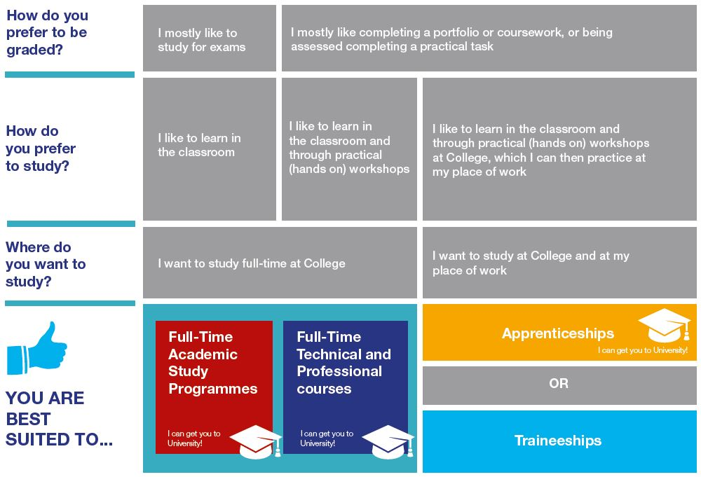
YEAR 11 WRL
How to decide which Post 16 Option is best for you:

Slide 5
YEAR 11 WRL
FULL-TIME ACADEMIC QUALIFICATIONS
You will be taking A Levels:
Studied over two years, final exams at the end
You will normally take 3 A levels and in the first year you may take an AS level (half an A Level)
Less course work
Emphasis on final exams

Slide 6
YEAR 11 WRL
FULL-TIME TECHNICAL AND PROFESSIONAL QUALIFICATIONS
These include: BTEC/Cambridge Certificates, Diplomas, Extended Diplomas & T-Levels (equiv. to 1, 2 or 3 A Levels):
These are more work related:
More coursework; up to 100%
One specific subject/career area
Work experience
Can be combined with A levels

Slide 7
YEAR 11 WRL
FULL-TIME TECHNICAL AND PROFESSIONAL QUALIFICATIONS
These cover a broad range of professions:
Accountancy Animal Care Art & Design Beauty Therapies
Business Catering Childcare Computer Science
Construction Criminology Dance Dental Nursing
Digital Communication Electrical Engineering Environmental Studies
Event Management Game Design Hairdressing/Barbering Health & Social Care
Horticulture Hospitality & Catering Marine Studies Media Motor Sport
Photography Plumbing Public Services Retail Sport & Fitness
Travel & Tourism Uniformed Service Veterinary Nursing and more………

Slide 8
YEAR 11 WRL
Full-Time Academic – A Levels / BTEC Certificates and Diplomas available at:
Andover College
Barton Peveril College
Bishop Wordsworth’s School
Itchen College
Peter Symonds College
QMC
Richard Tauntons College
Winchester College
Full-Time Technical and Professional Study Programmes available at:
Academy of Music
AHED Centre / Peter Symonds College
Andover College
BCoT (Basingstoke College)
Eastleigh College
Fareham College
Itchen College
QMC
Southampton City College
Sparsholt College
THESE ARE DESTINATIONS CHOSEN BY PREVIOUS KINGS’ STUDENTS, BUT NOT AN EXHAUSTIVE LIST

Slide 9
YEAR 11 WRL
APPRENTICESHIP/TRAINEESHIP
These cover a broad range of professions, from Nursing to Hairdressing to becoming a Solicitor:
Earn as you learn – in paid employment
4 days per week in the work place, one day at college or training centre
Work along side experienced employees to be trained in the skills employers want
Starting salary approximately £100 per week, some employers offer more
Salary increases as you become more skilled
Available after GCSEs, A levels/Technical/Professional Qualification and as a degree/post graduate qualification
Use the following resources to find out more about apprenticeships and how to apply for them:
https://vimeo.com/151121127
https://amazingapprenticeships.com/
https://assets.ctfassets.net/8kbr1n52z8s2/Ygfxd2kedxthdUH8t4hNl/ad8a1063a625ea2c16c39fc40904a58d/Parent_and_Carers-_Pack_July_2023.pdf?consent_uid=l35ocYZXQkSyaaGFyx-Mxw

Slide 10
YEAR 11 WRL
HOW KINGS’ WILL HELP YOU?
From September:
Careers & Employability Fair: Wednesday 20th September
Personalised 1:1 careers interview
Help with applications and personal statement
Assemblies and Career Master Classes
Mock interviews
Mentoring programme
Taster days / visits
Kings’ careers website ‘Resource Companion’ (available via the school website)
Virtual Careers Fayre for you and parents
Use this button to investigate all the useful information available on Post 16 options and future careers (user name / password: careerking). Once you have accessed the Career Companion website, the Careers Fair can be found via the quick links menu.

Slide 11
YEAR 11 WRL
Useful information to consider:
Have a think about which post 16 option(s) best suit you (how you prefer to learn)
Attend multiple open events to explore different colleges and/or employers, this will help you make informed choices
You can make multiple college/sixth form applications, accept all offers and then make your final choice once you receive your GCSE results
You can apply for more than one option (e.g. college and an apprenticeship)
Talk to college tutors, employers, current students/apprentices, friends and family about courses, careers and experiences
Look online and in prospectus to gather information about different courses/apprenticeships and the education/career pathways they lead on to
Check online for application opening and closing dates, most colleges open applications from early September, whereas many employers recruit apprentices throughout the year
Submit your application(s) as soon as you can to avoid rushing or missing deadlines

